Slide 1
TUTTOFOOD 2026 Buyers Program
martedì 9 giugno 2026

Slide 2
1060
Risposte totali
Data di creazione: lunedì 11 maggio 2026
Risposte complete: 1060

Slide 3
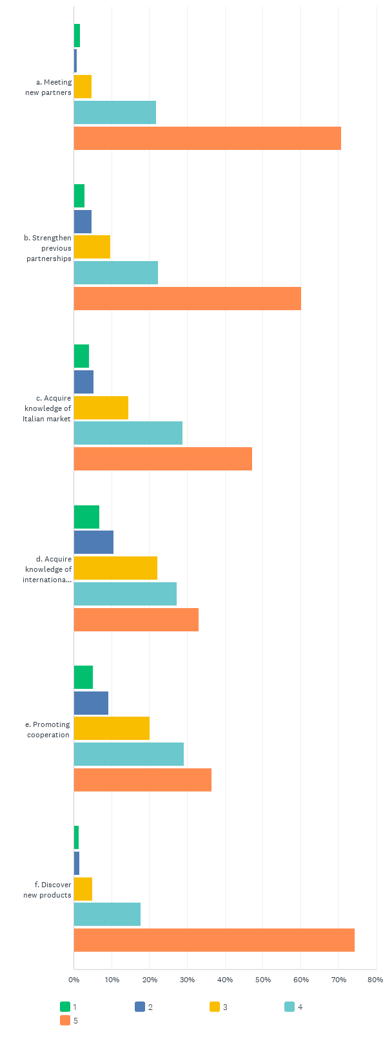
D2: What have been, for your company, the most important reasons to attend TUTTOFOOD? Please rate each field on a scale from 1 to 5, with 1 being "Not Important At All” and 5 being “Very Important”.
Risposte: 1017 .: 43

Slide 4
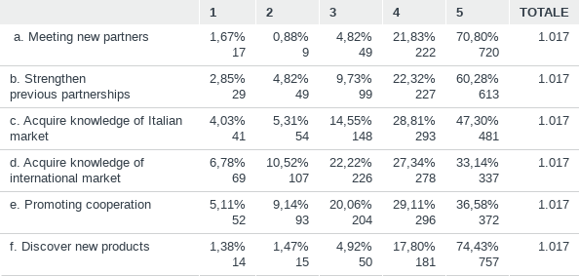
D2: What have been, for your company, the most important reasons to attend TUTTOFOOD? Please rate each field on a scale from 1 to 5, with 1 being "Not Important At All” and 5 being “Very Important”.
Risposte: 1017 .: 43

Slide 5
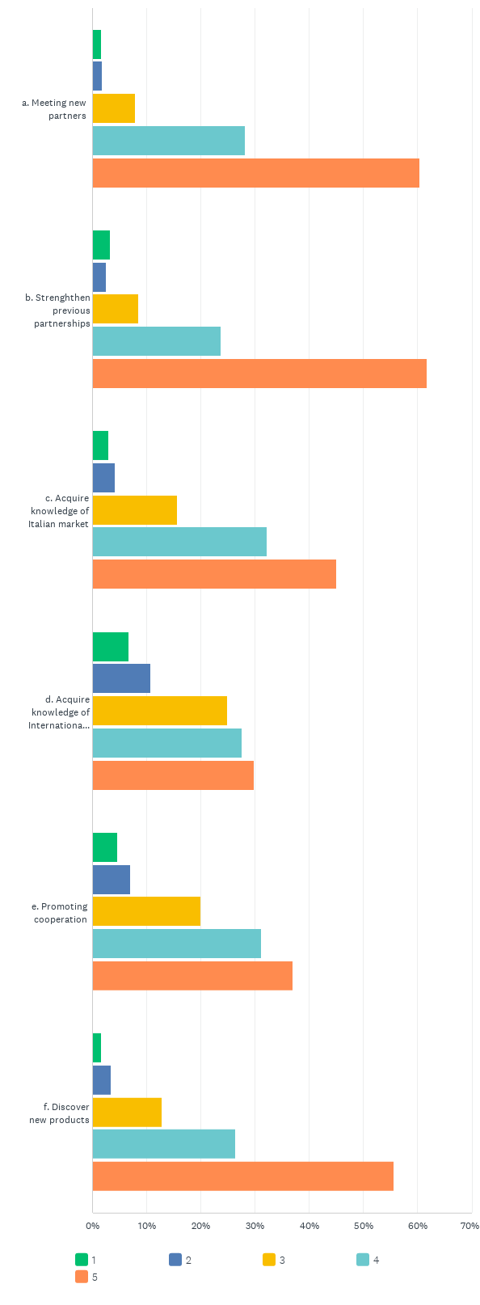
D3: Do you think you have reached any of your objectives? To what extent? Please rate each field on a scale from 1 to 5, with 1 being "Not At All" and 5 being “To A Great Extent”.
Risposte: 1017 .: 43

Slide 6
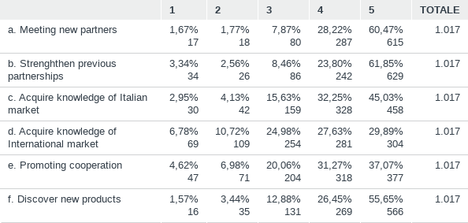
D3: Do you think you have reached any of your objectives? To what extent? Please rate each field on a scale from 1 to 5, with 1 being "Not At All" and 5 being “To A Great Extent”.
Risposte: 1017 .: 43

Slide 7
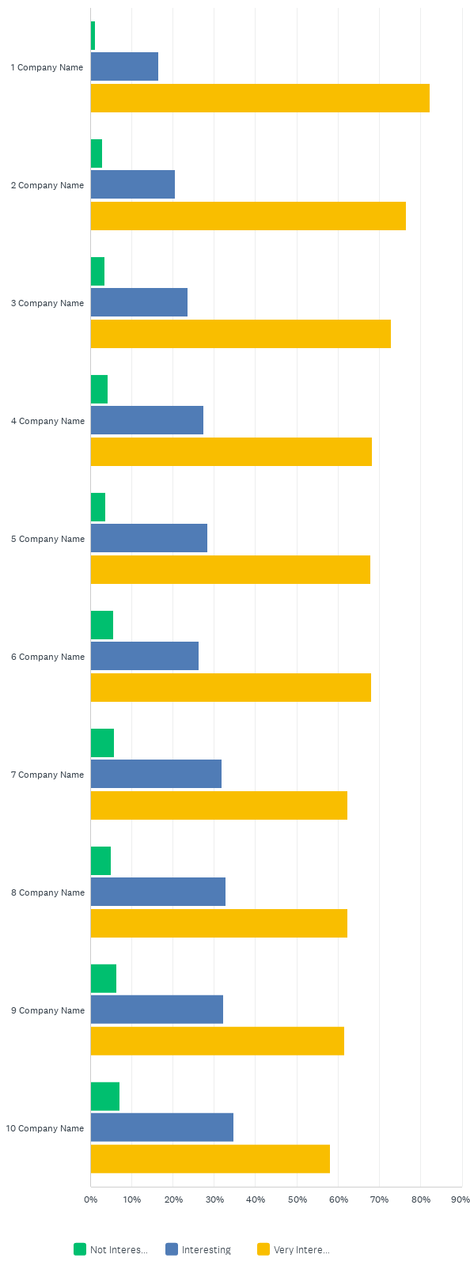
D4: Could you mention and rate some of the companies you have met?
Risposte: 827 Saltate: 233

Slide 8
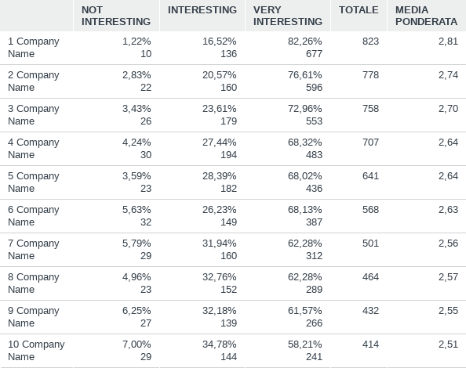
D4: Could you mention and rate some of the companies you have met?
Risposte: 827 Saltate: 233

Slide 9
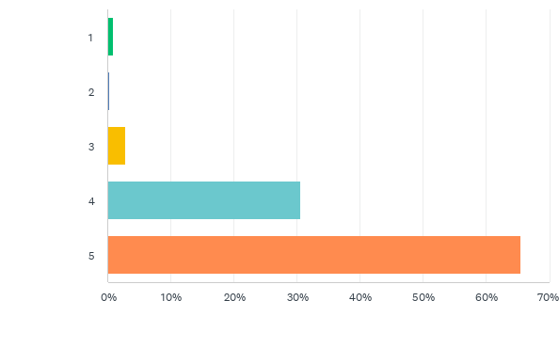
D5: How do you evaluate the quality standard of the exhibiting companies at TUTTOFOOD? Please rate on a scale from 1 to 5, with 1 being "Very Bad" and 5 being "Very Good".
Risposte: 936 Saltate: 124

Slide 10
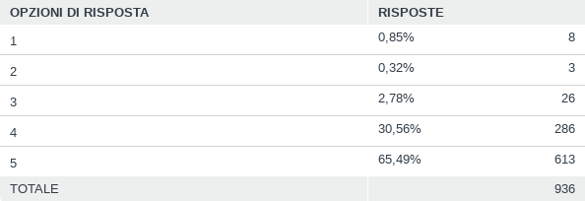
D5: How do you evaluate the quality standard of the exhibiting companies at TUTTOFOOD? Please rate on a scale from 1 to 5, with 1 being "Very Bad" and 5 being "Very Good".
Risposte: 936 Saltate: 124

Slide 11
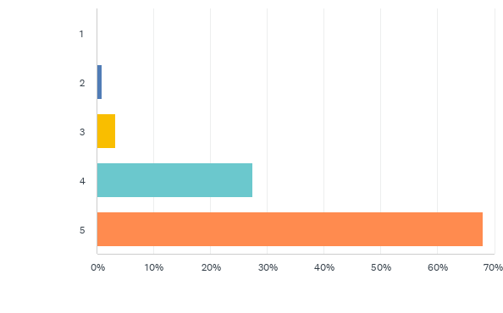
D6: How do you evaluate the quantity of the exhibiting companies at TUTTOFOOD? Please rate on a scale from 1 to 5, with 1 being "Very Bad" and 5 being "Very Good".
Risposte: 933 Saltate: 127

Slide 12
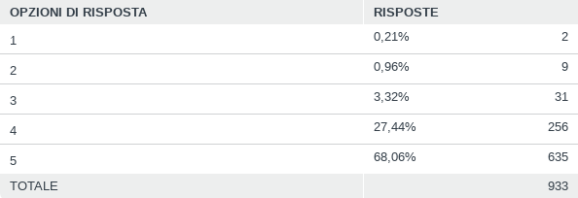
D6: How do you evaluate the quantity of the exhibiting companies at TUTTOFOOD? Please rate on a scale from 1 to 5, with 1 being "Very Bad" and 5 being "Very Good".
Risposte: 933 Saltate: 127

Slide 13
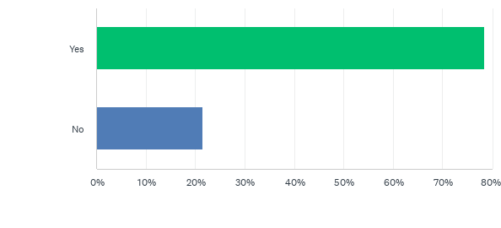
D7: Did you use the Business Agenda?
Risposte: 933 Saltate: 127

Slide 14
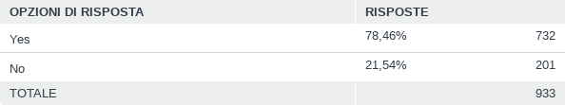
D7: Did you use the Business Agenda?
Risposte: 933 Saltate: 127

Slide 15
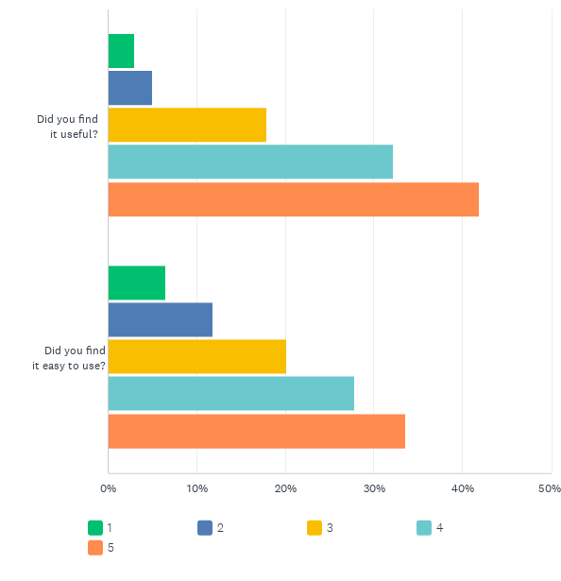
D8: How do you evaluate the Business Agenda? Please rate each field on a scale of 1 to 5, with 1 being "not satisfied at all" and 5 being "very satisfied".
Risposte: 733 Saltate: 327

Slide 16
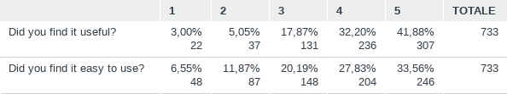
D8: How do you evaluate the Business Agenda? Please rate each field on a scale of 1 to 5, with 1 being "not satisfied at all" and 5 being "very satisfied".
Risposte: 733 Saltate: 327

Slide 17
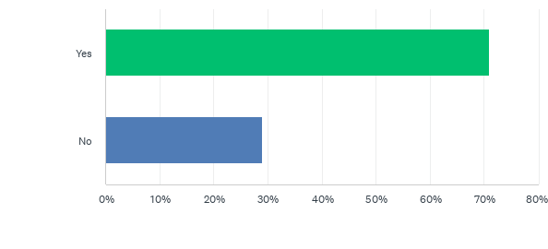
D9: Did you attend all of the scheduled meetings?
Risposte: 732 Saltate: 328

Slide 18
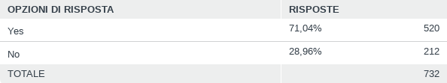
D9: Did you attend all of the scheduled meetings?
Risposte: 732 Saltate: 328

Slide 19
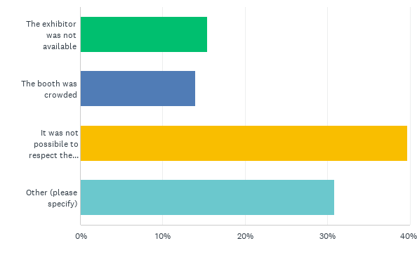
D10: Why did you not attend all the scheduled meetings?
Risposte: 214 Saltate: 846

Slide 20
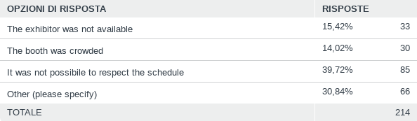
D10: Why did you not attend all the scheduled meetings?
Risposte: 214 Saltate: 846

Slide 21
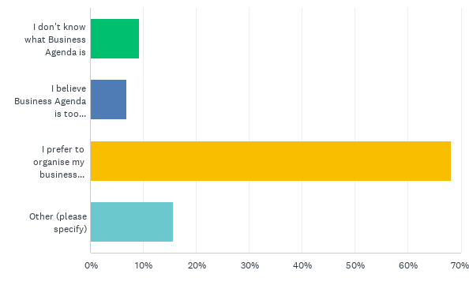
D11: Why did you not use the Business Agenda?
Risposte: 204 Saltate: 856

Slide 22
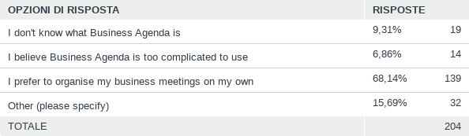
D11: Why did you not use the Business Agenda?
Risposte: 204 Saltate: 856

Slide 23
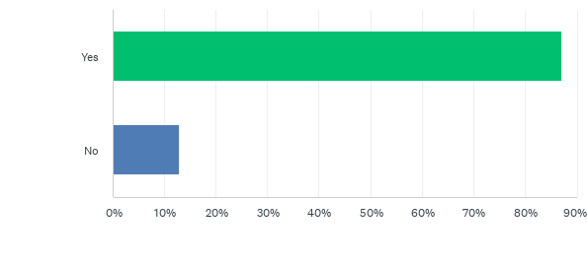
D12: Did you access the TUTTOFOOD APP?
Risposte: 931 Saltate: 129

Slide 24
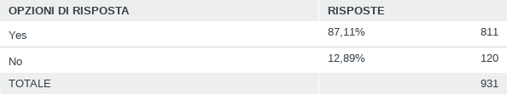
D12: Did you access the TUTTOFOOD APP?
Risposte: 931 Saltate: 129

Slide 25
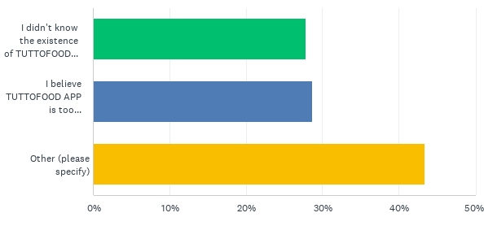
D13: Why did you not access the TUTTOFOOD APP?
Risposte: 122 Saltate: 938

Slide 26
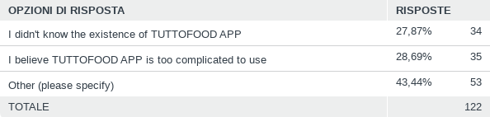
D13: Why did you not access the TUTTOFOOD APP?
Risposte: 122 Saltate: 938

Slide 27
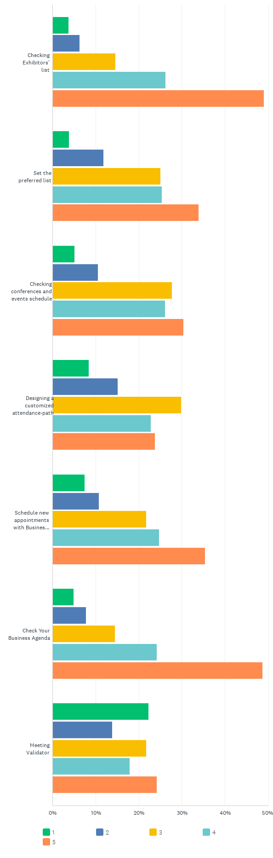
D14: How useful was the TUTTOFOOD APP for the following actions? Please rate each field on a scale of 1 to 5, with 1 being "not satisfied at all" and 5 being "very satisfied".
Risposte: 809 Saltate: 251

Slide 28
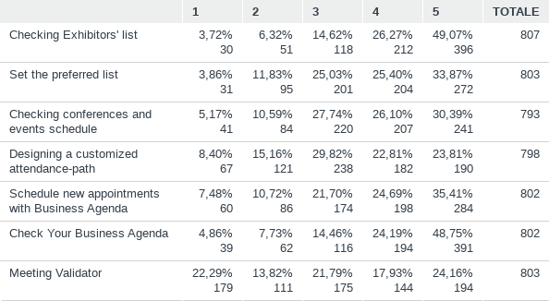
D14: How useful was the TUTTOFOOD APP for the following actions? Please rate each field on a scale of 1 to 5, with 1 being "not satisfied at all" and 5 being "very satisfied".
Risposte: 809 Saltate: 251

Slide 29
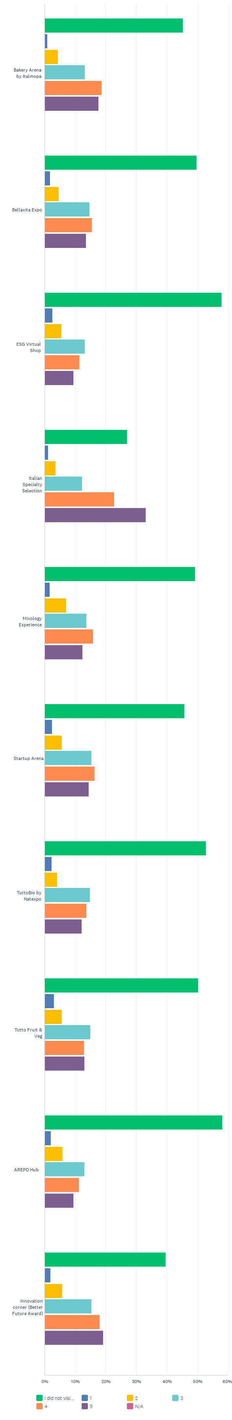
D15: How interesting did you find the special areas featured at Tuttofood 2026?Please rate them on a scale from 1 to 5, where 1 is "Not At All Interesting" and 5 is "Very Interesting"
Risposte: 893 Saltate: 167

Slide 30
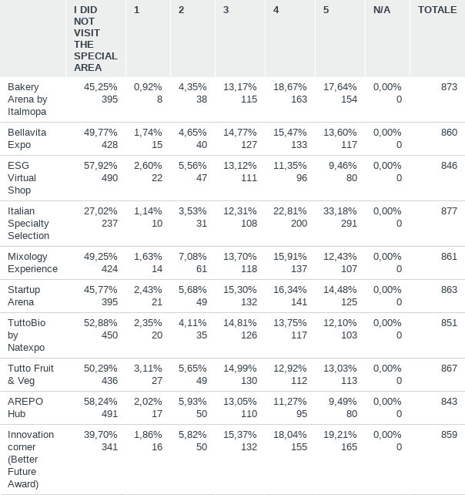
D15: How interesting did you find the special areas featured at Tuttofood 2026?Please rate them on a scale from 1 to 5, where 1 is "Not At All Interesting" and 5 is "Very Interesting"
Risposte: 893 Saltate: 167

Slide 31
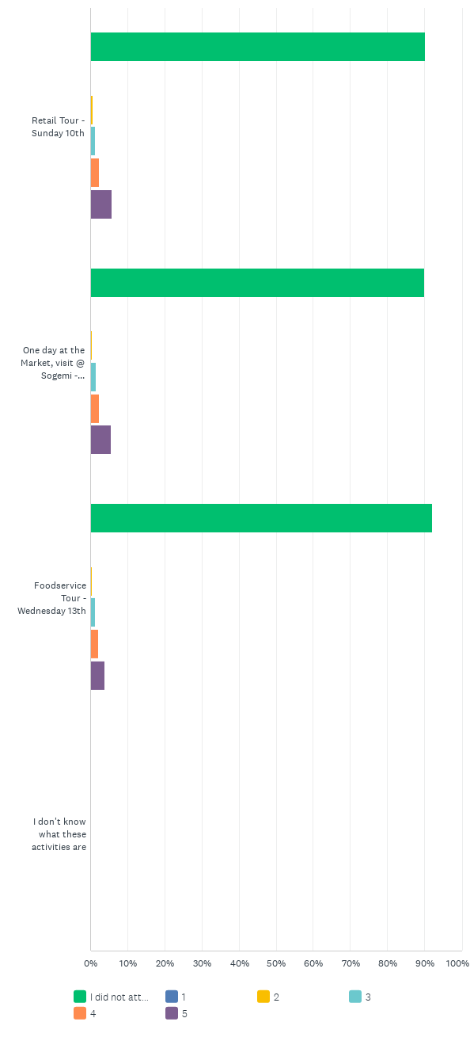
D16: Have you attended the following special activities outside the exhibition? What is your evaluation?Please rate each field on a scale from 1 to 5, with 1 being "Very Dissatisfying" and 5 being "Very Satisfying".
Risposte: 921 Saltate: 139

Slide 32
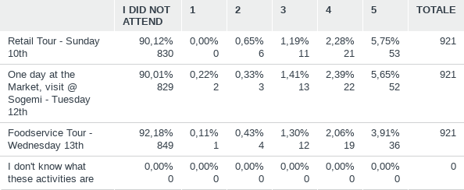
D16: Have you attended the following special activities outside the exhibition? What is your evaluation?Please rate each field on a scale from 1 to 5, with 1 being "Very Dissatisfying" and 5 being "Very Satisfying".
Risposte: 921 Saltate: 139

Slide 33
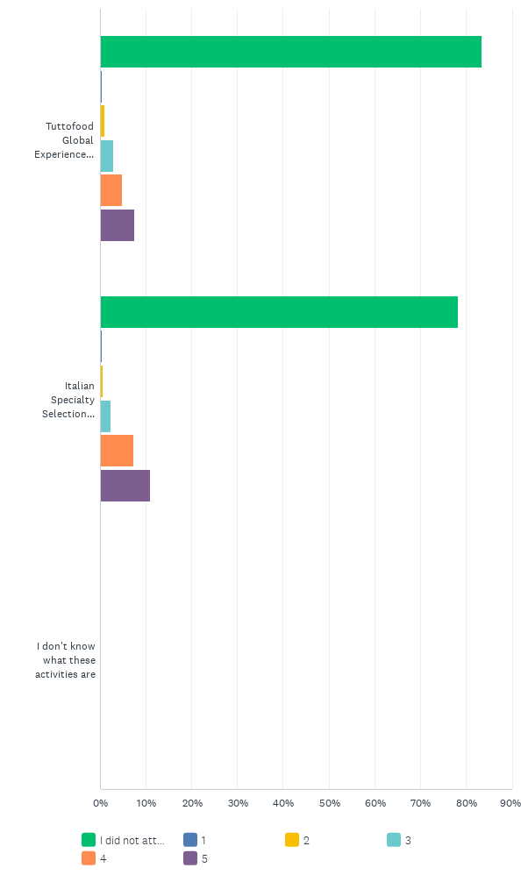
D17: Have you attended one of the tours inside the exhibition? What is your evaluation?Please rate each field on a scale from 1 to 5, with 1 being "Very Dissatisfying" and 5 being "Very Satisfying".
Risposte: 918 Saltate: 142

Slide 34
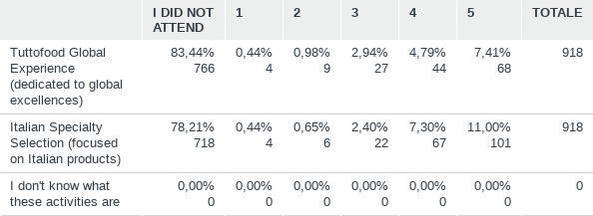
D17: Have you attended one of the tours inside the exhibition? What is your evaluation?Please rate each field on a scale from 1 to 5, with 1 being "Very Dissatisfying" and 5 being "Very Satisfying".
Risposte: 918 Saltate: 142

Slide 35
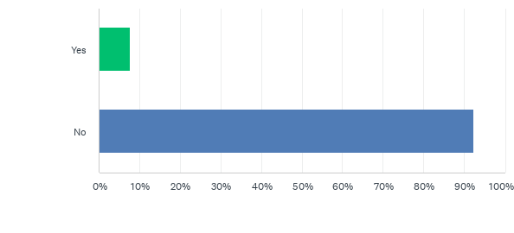
D18: Have you attended one of the conferences? If yes, which one(s)?
Risposte: 909 Saltate: 151

Slide 36
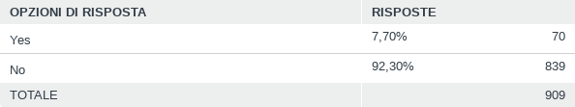
D18: Have you attended one of the conferences? If yes, which one(s)?
Risposte: 909 Saltate: 151

Slide 37
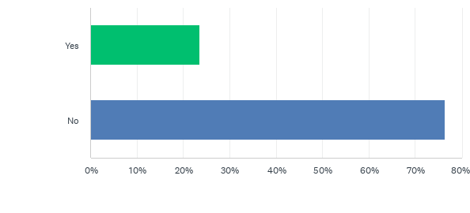
D19: Did you make use of the innovative translation service made available to all visitors via their personal devices for this edition?
Risposte: 72 Saltate: 988

Slide 38
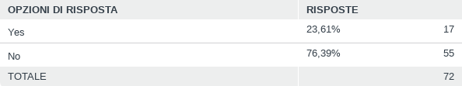
D19: Did you make use of the innovative translation service made available to all visitors via their personal devices for this edition?
Risposte: 72 Saltate: 988

Slide 39
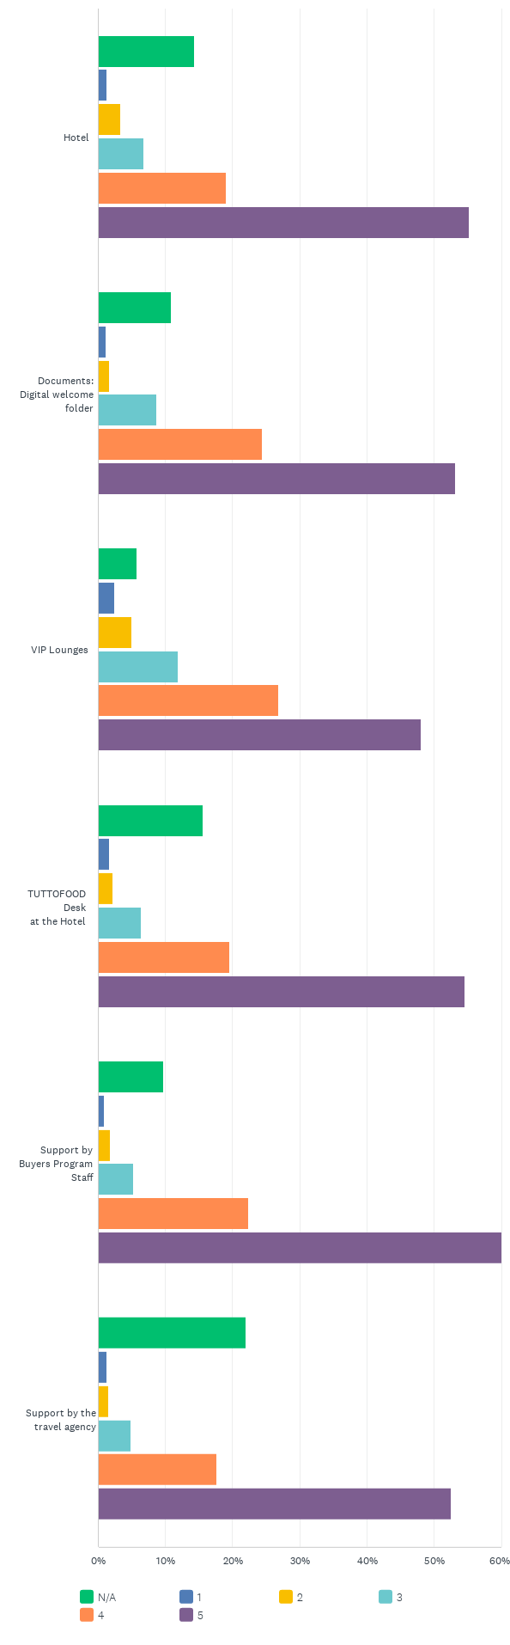
D20: How do you evaluate these services provided by TUTTOFOOD Buyers Program?Please rate each field on a scale from 1 to 5, with 1 being "Not Satisfied At All" and 5 being "Very Satisfied".
Risposte: 917 Saltate: 143

Slide 40
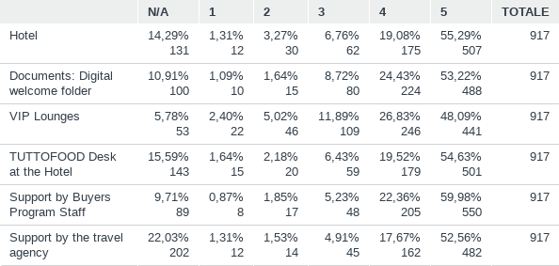
D20: How do you evaluate these services provided by TUTTOFOOD Buyers Program?Please rate each field on a scale from 1 to 5, with 1 being "Not Satisfied At All" and 5 being "Very Satisfied".
Risposte: 917 Saltate: 143

Slide 41

D21: What's your overall impression of TUTTOFOOD 2026? Please answer on a scale from 1 to 5.
Risposte: 914 Saltate: 146

Slide 42

D21: What's your overall impression of TUTTOFOOD 2026? Please answer on a scale from 1 to 5.
Risposte: 914 Saltate: 146

Slide 43
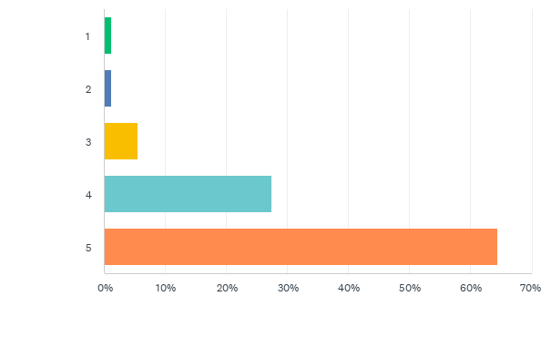
D22: What's your overall impression of TUTTOFOOD 2026 Buyers Program? Please answer on a scale from 1 to 5.
Risposte: 914 Saltate: 146

Slide 44
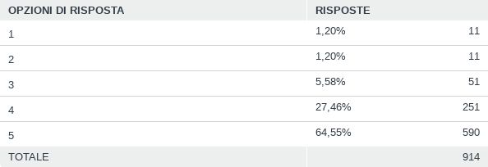
D22: What's your overall impression of TUTTOFOOD 2026 Buyers Program? Please answer on a scale from 1 to 5.
Risposte: 914 Saltate: 146

Slide 45
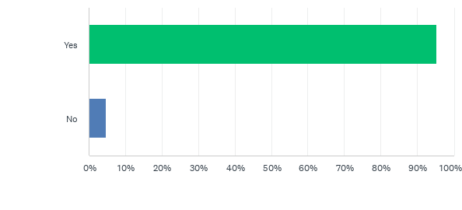
D24: Are you planning to attend TUTTOFOOD in 2028 (May 8th-11th)?
Risposte: 913 Saltate: 147

Slide 46
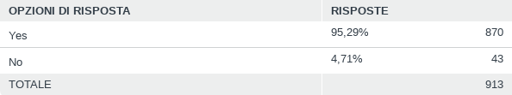
D24: Are you planning to attend TUTTOFOOD in 2028 (May 8th-11th)?
Risposte: 913 Saltate: 147

Slide 47
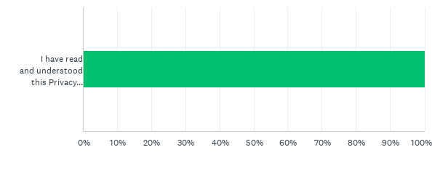
D25: I have read the privacy policy
Risposte: 908 Saltate: 152

Slide 48

D25: I have read the privacy policy
Risposte: 908 Saltate: 152

Slide 49
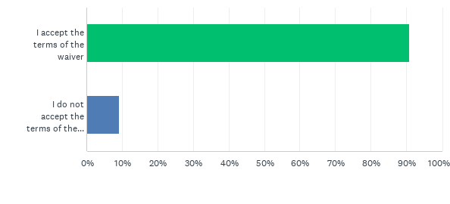
D26: WaiverThe Data Controller informs the data subjects that in case of acceptance of the conditions contained herein, Fiere di Parma may propose the name and content of the point "YOUR OPINION IS IMPORTANT TO US: We would love to hear your thoughts about TUTTOFOOD, please feel free to leave a comment or a summary about your personal experience" of the questionnaire filled out by the data subjects for its promotional and marketing purposes. The above material may be published on the company website, on the social networks managed by the data controller and/or on company brochures. The Data Controller declares that they will not be used in ways that may damage the subject's personal dignity and decorum, and that all the rights set forth by applicable laws in force at the time of signing this waiver shall be safeguarded.
Risposte: 906 Saltate: 154

Slide 50
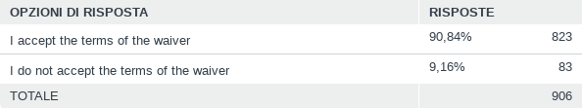
D26: WaiverThe Data Controller informs the data subjects that in case of acceptance of the conditions contained herein, Fiere di Parma may propose the name and content of the point "YOUR OPINION IS IMPORTANT TO US: We would love to hear your thoughts about TUTTOFOOD, please feel free to leave a comment or a summary about your personal experience" of the questionnaire filled out by the data subjects for its promotional and marketing purposes. The above material may be published on the company website, on the social networks managed by the data controller and/or on company brochures. The Data Controller declares that they will not be used in ways that may damage the subject's personal dignity and decorum, and that all the rights set forth by applicable laws in force at the time of signing this waiver shall be safeguarded.
Risposte: 906 Saltate: 154

